Slide 1

Object Basics
Using Objects
Defining Objects
Encapsulation/API
Terminology/Naming
Notes:
We’ll look at the OO basic syntax here. Next lesson we’ll look at constructors, operator overloads, and static members

Slide 2

See Also
https://www.youtube.com/watch?v=pTB0EiLXUC8
https://dev.to/charanrajgolla/beginners-guide---object-oriented-programming
Notes:
Here is some additional reading on the web.

Slide 3
Using Objects
CREATE
(Heap)
logger = RootLogger()
logger.setLevel(DEBUG)
logger.warning('Bad things!')
logger.debug('Starting up')
b = logger.isEnabledFor(WARN)
Python
USE
CREATE
(Heap)
CSVReader csv = new CSVReader("mydata.csv");
String [] row = csv.getNextRow();
csv.close();
Java
USE
Garbage Collected
Garbage Collected
CREATE
(Heap)
RESTClient * client = new RESTClient("https://io.ada.com");
string resp = client->get("/freezer_data");
client->post("/freezer_data", "-10.5");
delete client;
C++
USE
CREATE
(Stack or nested)
RESTClient client("https://io.ada.com");
string resp = client.get("/freezer_data");
client.post("/freezer_data", "-10.5");
C++
USE
Manual Delete
Automatic Delete
Notes:
#15 You get to decide when the object can be deleted (not always easy to know). A frequent error is to forget to delete it or delete it prematurely.
#22 AUTOMATIC DELETE is not garbage collection. It is immediately removed from memory, but here it happens automatically

Slide 4
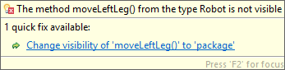

Defining Classes
class Robot {
private void moveLeftLeg() {
}
private void moveRightLeg() {
}
public void sayHi() {
System.out.println("Beep Beep");
}
public double getBatteryLevel() {
return 0.0;
}
public void goTo(double lat, double lng) {
moveLeftLeg();
moveRightLeg();
}
}
Java
Robot rob = new Robot();
rob.sayHi();
double charge = rob.getBatteryLevel();
rob.goTo(34.738, -86.60);
rob.moveLeftLeg();
Java
Notes:
The order of public/private doesn’t matter. In fact, the order doesn’t matter at all.
Order of public/private?
Public API
Naming conventions
Creating objects
Methods and self/this
Access (public, private) Enforced at runtime. Doesn’t mean much to python.

Slide 5
Defining Classes
class Robot {
private:
void moveLeftLeg() {
}
void moveRightLeg() {
}
public:
void sayHi() {
cout << "Beep Beep" << endl;
}
double getBatteryLevel() {
return 0.0;
}
void goTo(double lat, double lng) {
moveLeftLeg();
moveRightLeg();
}
};
C++
Robot * rob = new Robot();
rob->sayHi();
double charge = rob->getBatteryLevel();
rob->moveLeftLeg();
C++
error: 'void Robot::moveLeftLeg()' is private
void moveLeftLeg() {
^
error: within this context
rob->moveLeftLeg();
Notes:
Order of public/private?
Show “this.method” in future slide … when “this” makes sense with data
Public API
Naming conventions
Creating objects
Methods and self/this
Access (public, private) Enforced at runtime. Doesn’t mean much to python.

Slide 6

Defining Classes
class Robot:
def _move_left_leg(self):
pass
def _move_right_leg(self):
pass
def say_hi(self):
print('Beep Beep')
def get_battery_level(self):
return 0.0
def go_to(self,lat,lng):
self._move_left_leg()
self._move_right_leg()
def go_to(self,lat: float,lng: float) -> None:
Python
rob = Robot()
rob.say_hi()
lev = rob.get_battery_level()
rob.go_to(34.738, -86.60)
rob._move_left_leg()
Python
Notes:
Operator overloading next lesson
Order of public/private?
Show “this.method” in future slide … when “this” makes sense with data
Public API
Naming conventions
Creating objects
Methods and self/this
Access (public, private) Enforced at runtime. Doesn’t mean much to python.

Slide 7



Islands of Data
Robot bob = new Robot();
bob.goTo(20);
int x = bob.getLocation();
Robot jan = new Robot();
jan.goTo(30);
int y = jan.getLocation();
Robot pat = new Robot();
pat.goTo(50);
int z = pat.getLocation();
Java
Location: 20
Battery: 95%
Location: 30
Battery: 63%
Location: 50
Battery: 5%

Slide 8

Data Members
class Robot {
private int location;
private double battery;
public int getLocation() {
return location;
}
public void goTo(int loc) {
location = loc;
battery = battery - 0.10;
}
public void goTo(/*Robot this*/, int location) {
location = loc;
this.location = location;
battery = battery - 0.10;
}
}
Java
Robot bob = new Robot();
bob.goTo(20);
int x = bob.getLocation();
Robot jan = new Robot();
jan.goTo(50);
int y = jan.getLocation();
Java
location:
battery:
20
location:
battery:
50
public void goTo(Robot this, int loc) {
this.location = loc;
}
public int getLocation(Robot this) {
return this.location;
}
Java

Slide 9

Data Members
class Robot:
def goTo(self,_location):
self._location = _location
battery = battery - 0.10;
def get_location(self):
return self._location
Python
bob = Robot()
bob.go_to(20)
x = bob.get_location()
jan = Robot()
jan.go_to(50)
y = jan.get_location()
bob.color = 'Blue'
bob._location = 100
Python
_location: 20
_location: 50
color: 'Blue'
Notes:
Notice there is no data definition. You can add data any time (usually a constructor … next lesson)

Slide 10
Data Members
class Robot {
int location;
double battery;
public:
int getLocation() {
return location;
}
void goTo(int loc) {
location = loc;
battery = battery - 0.10;
}
void goTo(/*Robot * this,*/ int location) {
this->location = location;
}
};
C++
Robot * bob = new Robot();
bob->goTo(20);
int a = bob->getLocation();
Robot * jan = new Robot();
jan->goTo(50);
int b = bob->getLocation();
int a = bob->location;
C++
Notes:
getLocation seems a little silly, right? Why not just make them public and let the user’s get them directly?

Slide 11



What Time is it?
How lack of encapsulation broke my arm
Time to Eat (Jan)
Time to Drink (Bob)
C++
Clock c;
int h = c.numSeconds / 3600;
Clock c;
int h = c.numSeconds / 3600;
int m = c.numSeconds / 60;
int s = c.numSeconds % 60;
C++
Nap Time (Me)
C++
class Clock {
public:
int numSeconds;
};
Time to Cook (Tom)
Clock c;
int h = c.numSeconds / 3600;
int m = c.numSeconds / 60;
int s = c.numSeconds % 60;
C++
Clock c;
int m = c.numSeconds / 60;
int s = c.numSeconds % 60;
C++
Notes:
Timely Tools Software
They use my clock because reuse is good.
No pets were harmed

Slide 12
What Time is it?
Time to Eat (Jan)
Time to Drink (Bob)
Nap Time (Me)
C++
Clock c;
int h = c.numSeconds / 3600;
Clock c;
int h = c.numSeconds / 3600;
int m = c.numSeconds / 60;
int s = c.numSeconds % 60;
C++
C++
class Clock {
public:
int numHours;
int numMinutes;
int numSeconds;
};
No plants or animals were harmed in this tragic tale.
Time to Cook (Tom)
Clock c;
int h = c.numHours;
int m = c.numMinutes;
int s = c.numSeconds;
C++
C++
Clock c;
int m = c.numSeconds / 60;
int s = c.numSeconds % 60;
Notes:
Timely Tools Software
They use my clock because reuse is good.
No pets were harmed

Slide 13

What Time is it?
Use Encapsulation !
GET HIM
Arrrrrrgg!
Notes:
You don’t see Jan in this photo. She came to my office and broke my arm.

Slide 14
What Time is it?
class Clock {
int numSeconds;
public:
int getHours() {
return numSeconds / 3600;
}
int getMinutes() {
return numSeconds / 60;
}
int getSeconds() {
return numSeconds % 60;
}
};
C++
Time to Eat (Jan)
C++
Clock c;
int h = c.getHours();
int m = c.getMinutes();
int s = c.getSeconds();
Time to Drink (Bob)
Clock c;
int h = c.getHours();
C++
Time to Cook (Tom)
Clock c;
int h = c.getHours();
int m = c.getMinutes();
int s = c.getSeconds();
C++
C++
Clock c;
int m = c.getMinutes(); int s = c.getSeconds();
Notes:
Timely Tools Software
They use my clock because reuse is good.
No pets were harmed

Slide 15
What Time is it?
class Clock {
int numHours;
int numMinutes;
int numSeconds;
public:
int getHours() {
return numHours;
}
int getMinutes() {
return numMinutes;
}
int getSeconds() {
return numSeconds;
}
};
C++
Time to Eat (Jan)
C++
Clock c;
int h = c.getHours();
int m = c.getMinutes();
int s = c.getSeconds();
Time to Drink (Bob)
Clock c;
int h = c.getHours();
C++
Time to Cook (Tom)
C++
Clock c;
int h = c.getHours();
int m = c.getMinutes();
int s = c.getSeconds();
Clock c;
int m = c.getMinutes(); int s = c.getSeconds();
C++
Notes:
Timely Tools Software
All the math is over here where it belongs … in the implementation of the clock.
They use my clock because reuse is good.
No pets were harmed

Slide 16
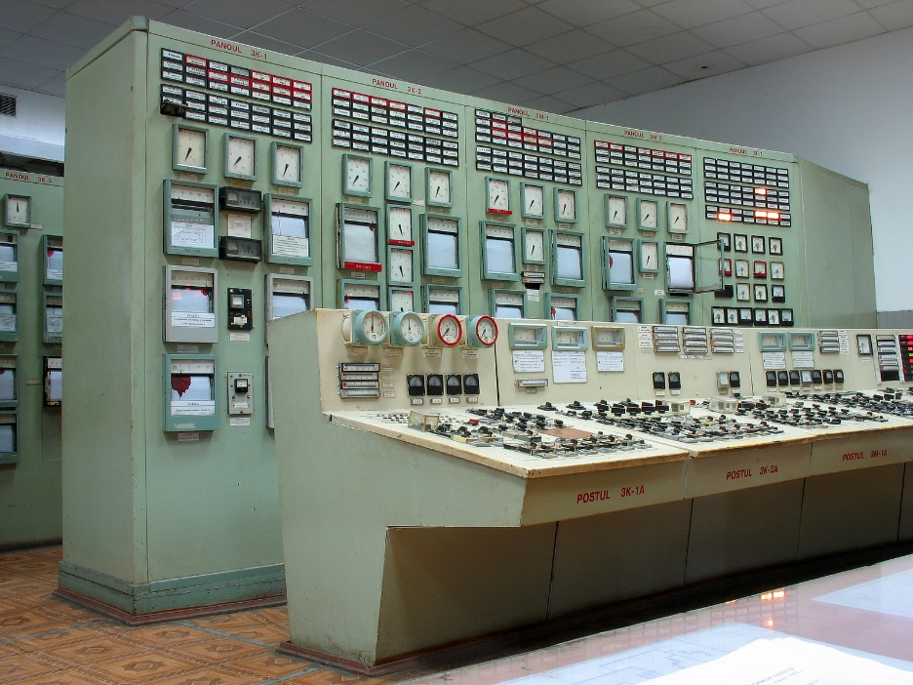
Public API
The public “Interface” – what can this object do?
The implementation – what is “inside” these objects?
Interface
Implementation is inside
Notes:
The “Interface” What “inside” these objects? We don’t know. We don’t care. They went to a lot of trouble to make this public interface for you. No need to open it up and dig around inside.
cater to the user, don’t make the user dock to your clunky interface
Don’t just use objects that are attributes in these examples. Use objects that do things.
Terminology: fields, instances, class, members, methods
Things we usually see: User(name,address,phone), Book(isbn,author,publisher). But what do we DO to these. Not much. Just data holders. A “true” object has behavior that we use.
Python: json, requests, files, sockets
Java: CSVReader, Collator
C++: <random>
Python List, Java ArrayList, C++ vector
- list (constructor, __len__, __reversed__, __setitem__, __sizeof__, __str__, append,__getitem__,insert,clear,copy,index,pop,remove,reverse,sort,__delitem__,__sizeof__)

Slide 17
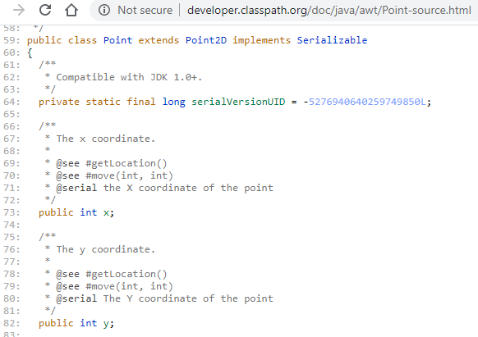
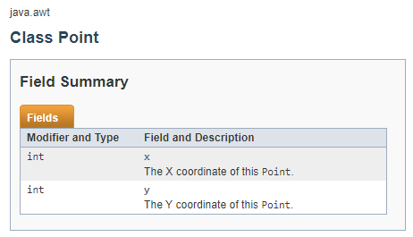

Performance Cost
Point p = new Point();
p.x = 20;
int k = p.x;
p.setX(20);
int m = p.getX();
Java
https://en.wikipedia.org/wiki/GNU_Classpath
Notes:
Java “Point” class has public members … for speed in the GUI library
C++ has “struct” … better word for these kinds of things?
Profile to find out
Need some insight into how it will be used in the future (crystal ball)

Slide 18




Terminology
Class
Members
class Robot {
private int location;
private double battery;
public int getLocation() { ... }
public void goTo(int loc) { ... }
}
Java
Fields
Methods
Class
Objects
Instances
Objects
Instance
Create a new instance of Robot
of Robot
Variables
Robot jan = new Robot();
Robot bob = new Robot();
bob.goTo(20);
Java
Jan is an instance of Robot
Calling method “goTo” on bob

Slide 19
Naming Conventions
Class names are generally NOUNS (Robot, Point, Button, Board)
Methods and functions are VERBS (getX, makeMove, sort)
Variables and member data are NOUNS (x, playerOne, length)
Class names start with an upper-case letter
Classes are named with “camel case” even in python (FastCar, ArrayList, UnitTestSorter)
Methods, functions, variables, fields start with lower case letter
Methods, functions, variables:
Java, C++: camel case (playerOne, currentGameBoard)
Python: snake case (player_one, current_game_board)
Notes:
Java peeps are more strict. Python has PEP8. C++ is much more loose.
Your project might have a firm coding standard. Try and adhere to the style of existing code.

Slide 20

Comparing Mechanics
C++
Java
Python
Defining,
Creating, and
Using Objects
class Point {
int x,y;
public:
int addX(int a) {
return x+a;
return this->x + a;
}
};
Point * p = new Point();
int a = p->addX(5);
Point q;
int b = q.addX(5);
class Point {
private int x,y;
public int addX(int a) {
return x+a;
return this.x + a;
}
}
Point p = new Point();
int a = p.addX(5);
class Point:
def addX(self,a):
return self.x + a
p = Point()
a = p.addX(5)
Notes:
Public-private differently (not at all in python … just a convention)
“this” is implicit – hidden except in python. “this” and “self” are there for you to use. The compiler will add it for you.
Using code is pretty similar. “new” to bring an object into existence on the heap. C++ has another option – entire lesson coming up on that.
Use the dot to access public data or call methods (arrow operator in C++)`

Slide 21

Tinkering
Compare the APIs for the following classes:
Python: List
Java: ArrayList
C++: vector
What methods/abilities do they have in common?
Notes:
Here are a couple of things to think about and/or try. This is totally optional … nothing for you to send to me.

